Slide 1


MIC Smart Beach by Bruce County
for Dr. Alex Smith
Sanjeev Kumar - Professor
Brunilda Xhaferllari – Project Manager
Rich Freeman – Faculty Mentor
AI Team:
Janvi Patel
Fangji Chen
Scaria Ouseph Kurian
Notes:
Image: 12019 (2016) Ocean waves crashing on shore during daytime https://pixabay.com/photos/beach-sea-sunset-sun-sunlight-1751455/

Slide 2
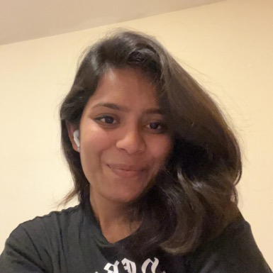
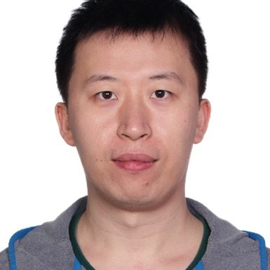
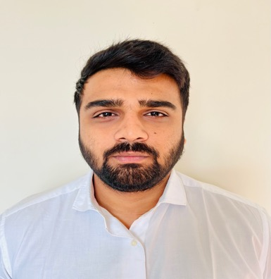

Our Team
Janvi
Patel
Scaria Ouseph Kurian
Fangji Chen
Project Lead / Communicator
Developer
Analyst

Slide 3

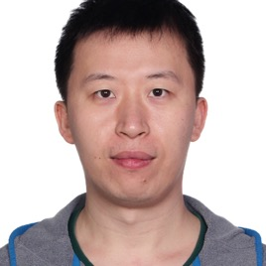
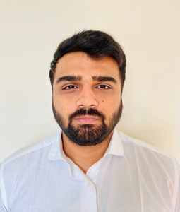
Who we are
I have a Bachelor of Computer Science degree from GTU. Prior to the Big Data Analysis program at Georgian College, I was a software developer. In terms of skills, I have high communication and organization with intermediate level experience in Python, Power BI, Machine Learning, and Deep Learning. I look forward to this project and our future weeks together.
I have a bachelor's degree in electronic information engineering and have 10 years of working experience in software engineering, data mining, and machine learning after graduating. I'm glad to work on this project and move forward with the group.
I have a Bachelor’s degree in computer science and a postgraduate program in Big Data Analytics and now I’m pursuing Artificial intelligence at Georgian college. I have an intermediate level experience in Power BI, Machine Learning, and Python. I’m glad to work on this project and move forward with this group.

Slide 4
Project Summary
The smart beach project is a three year pilot project that will provide swimmers with up-to-date information on water conditions.
The general project agenda is to use buoy(National oceanic and atmospheric administration) data and camera images to predict future water conditions.
There are 3 questions provided by MIC to the whole team of the which AI team will be working on the following question.
Predict the wave conditions and current visible in the camera images, as well the number and distribution of people on the beach and in the water.

Slide 5
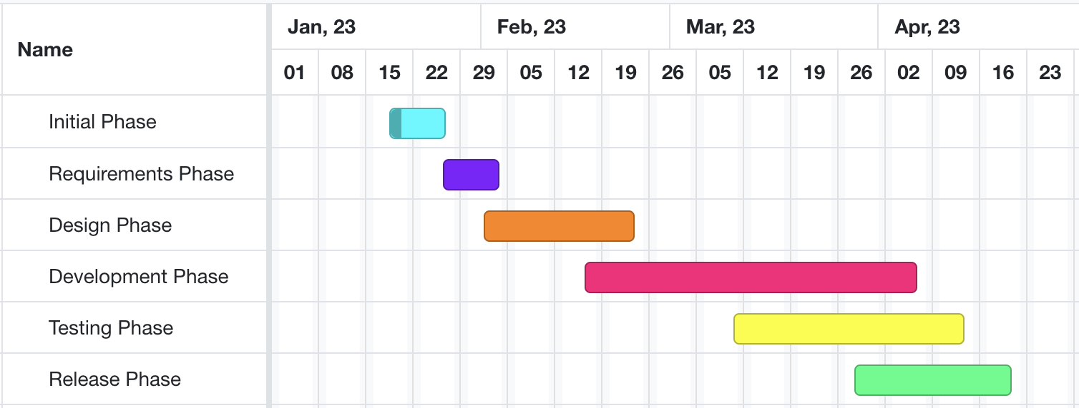
High-level GANTT Chart

Slide 6
Implementation Plan
Current Status: On track
Reuirement Phase
Data Cleaning and Analysis Phase
Development and Testing Phase
Release Phase
January 15th, 2023
January 30th , 2023
February 13th , 2023
April 3rd, 2023
Look for Image Privacy
Label Images
Train model with public data
February 20th, 2023
Handover of the Deliverables Phase
Time series visualizations
Model development
Model validation
January 9th, 2023
January 22nd, 2023
February 8th, 2023
February 15th, 2023
March 30th, 2023
Introduction to Project Charter and MRP Proposal
Retrieve public and
Client dataset
Model Design
Train model with client data
Create training and testing split
Model testing
Final report
Documentation/preparation
April 5th, 2023
Project Close-Out Phase

Slide 7
Model Path
Image Annonymizing
Image Classification
Crowd Counting

Slide 8
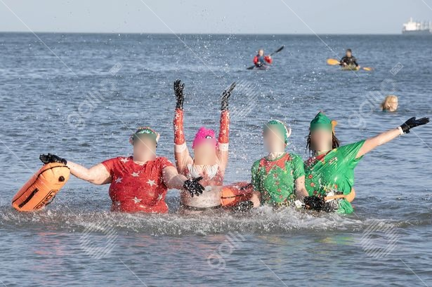
Image Anonymizing
Gallio
One day Subscription($8.00).
Results.
Github link:
https://github.com/franciszero/csp.pytorch

Slide 9
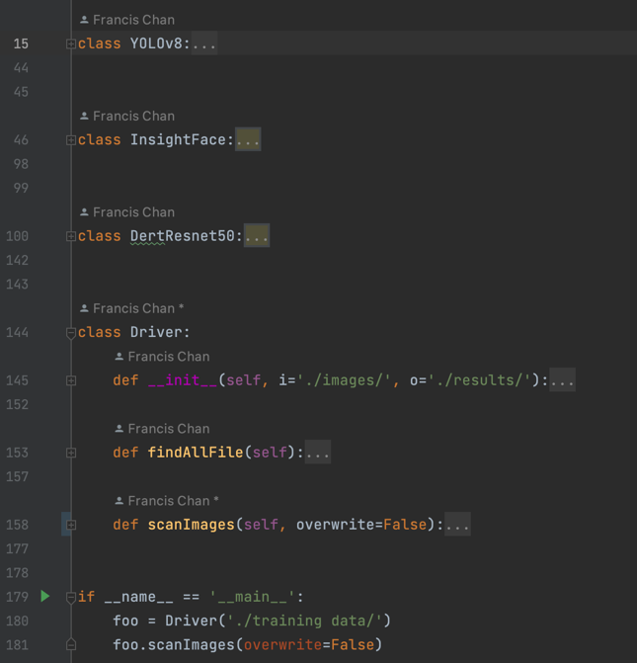
Comparing 3 models:
Prepare validation images
Researching and choosing candidate models as a baseline
This baseline is going to be used to measure how well our YOLOv5 model performs compares to those pre-trained models.
Prepare development environments for these baseline models
Run baseline models and analyze the results for good cases and bad cases
To be Continued

Slide 10
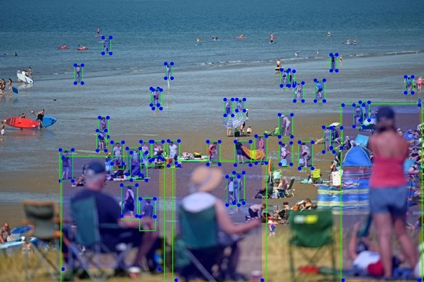
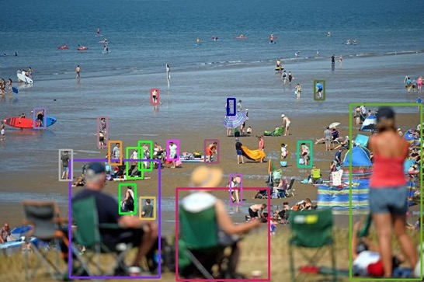
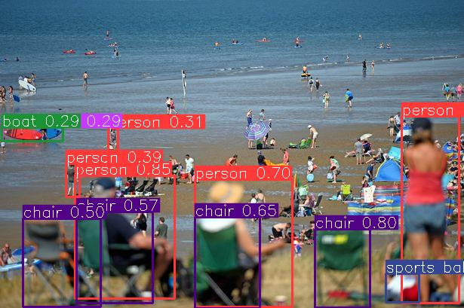
Insightface vs Resnet vs YOLOv8

Slide 11
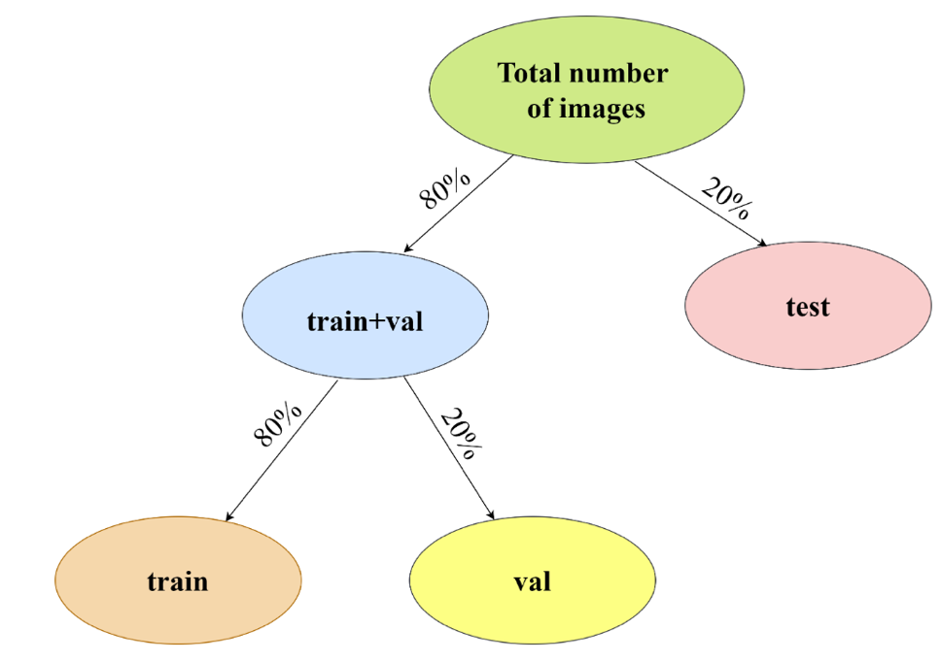
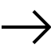
Additional activities since last report
Work:
Classification model for images.
Vgg19 was used for classification.
Transfer learning used to training the model.
Notes:
Padrinan, Miguel (n.d.). Email blocks on Gray Surface. Accessed on January 16th, 2023 from https://www.pexels.com/photo/email-blocks-on-gray-surface-1591062/

Slide 12
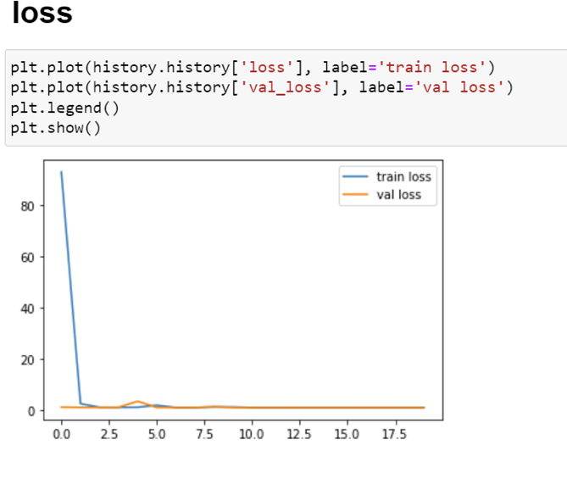
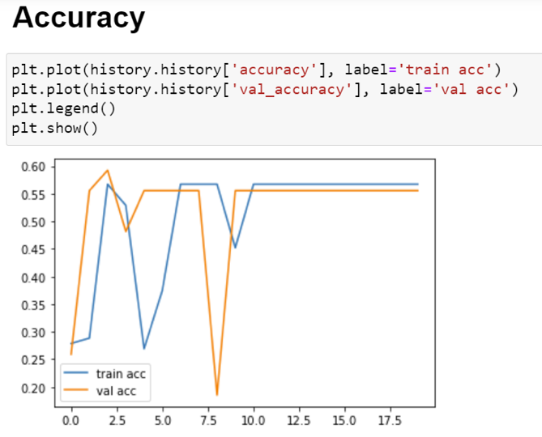
Updates
Classification model VGG9.
Structure of train_test chosen 80-20.
Will have to increase the accuracy of the model.
Testing required.
Notes:
Olexa, Peter (n.d.) A Person Making a Schedule. Accessed on January 18th, 2023 from https://www.pexels.com/photo/a-person-making-a-schedule-14299948/

Slide 13
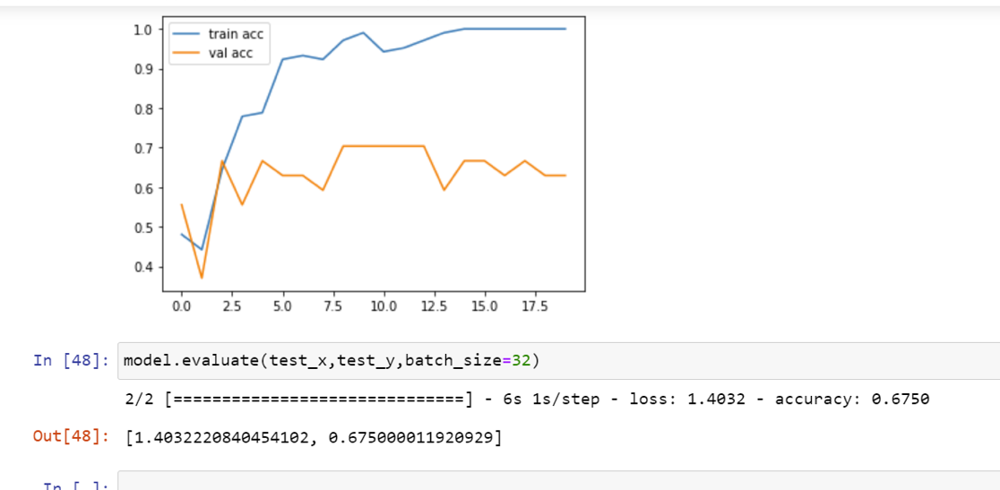
Pre-Trained VGG19 model

Slide 14
ResNet implementation :
Implemented the ResNet model.
We have stored the results in a txt file.
Classification model:
Implementation of classification models.
For comparison we will be implementing: MCNN(multi-column convolutional neural network.
CSRNet
SANet
ResNet
Inception

Slide 15
Individual Status Report - Janvi:
Till now I am working on the classification part.
Figuring available pre-trained models for crowd density.
Implementing models for accuracy checks.
Notes:
Olexa, Peter (n.d.) A Person Making a Schedule. Accessed on January 18th, 2023 from https://www.pexels.com/photo/a-person-making-a-schedule-14299948/

Slide 16
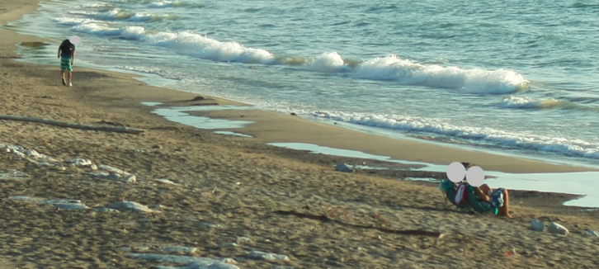
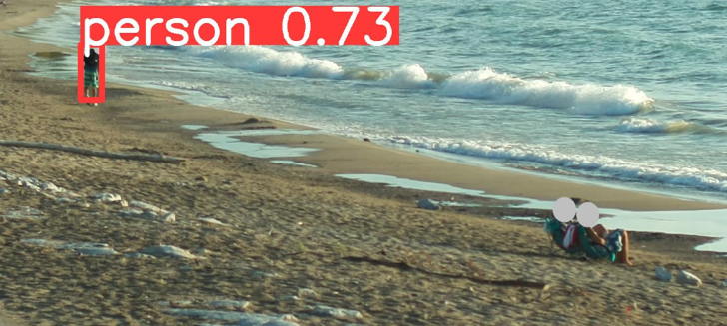
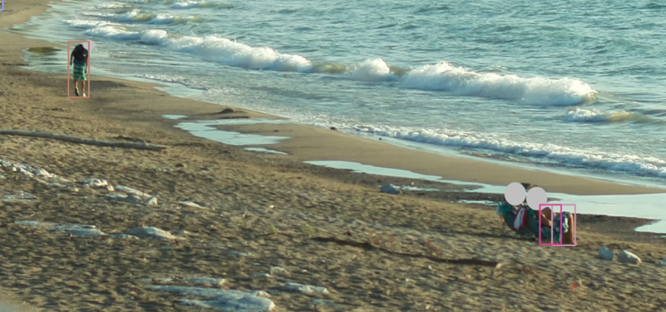
Individual Status Report – Fangi
Potential difficulties of people counting with anonymized images
InsightFace:0
YOLOv8s:1
ResNet:3
with leg pattern

Slide 17
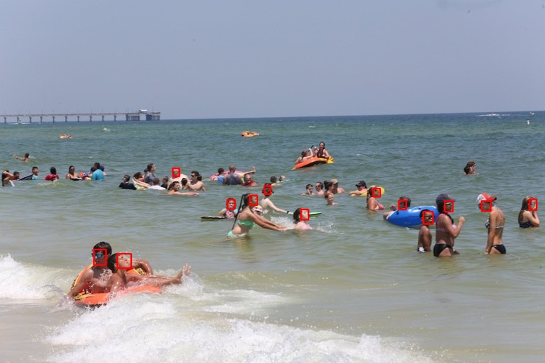
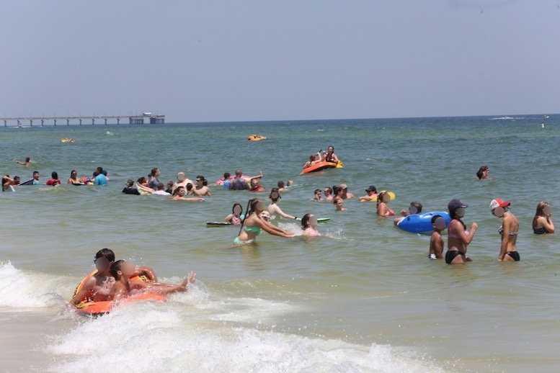
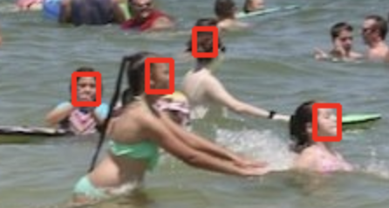
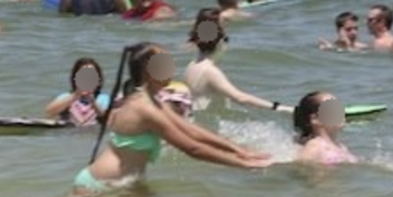
Individual Status Report – Fangi
Anonymizing with face detection
If we don’t have body patterns but heads, we may lose accuracy.
Then this is an anonymizing practice with face detection outputs, as an option.
* https://github.com/franciszero/csp.pytorch
Notes:
Olexa, Peter (n.d.) A Person Making a Schedule. Accessed on January 18th, 2023 from https://www.pexels.com/photo/a-person-making-a-schedule-14299948/

Slide 18
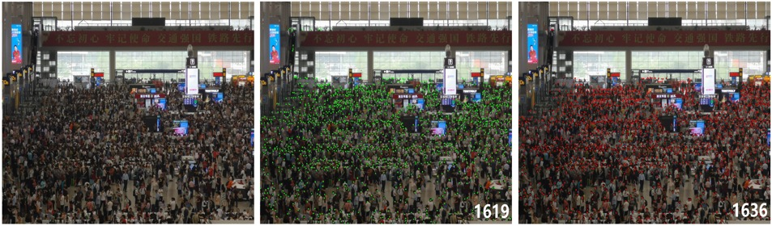
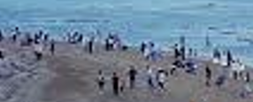
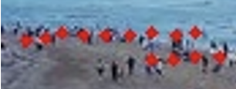
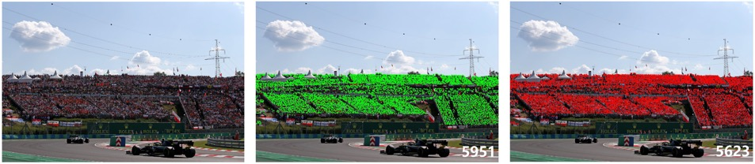
Individual Status Report – Fangi
An implementation of Crowd Counting with P2PNet – head patterns
This works for crowd counting but is applicable to limited scenarios
* https://github.com/franciszero/CrowdCounting-P2PNet
Notes:
Olexa, Peter (n.d.) A Person Making a Schedule. Accessed on January 18th, 2023 from https://www.pexels.com/photo/a-person-making-a-schedule-14299948/

Slide 19
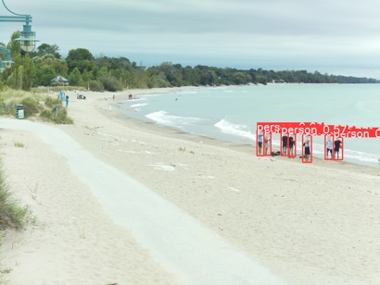
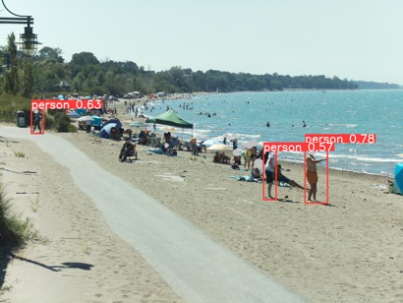
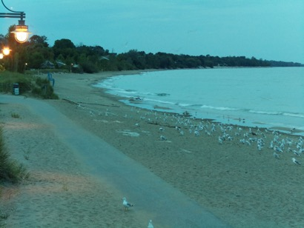
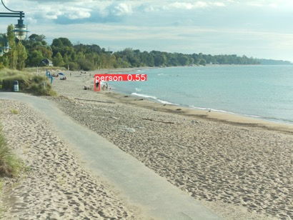
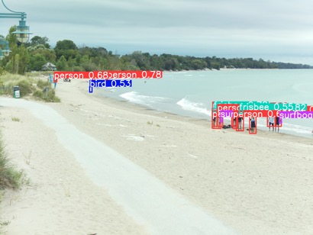
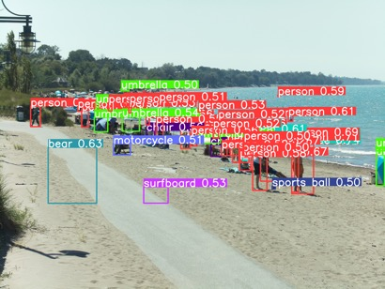
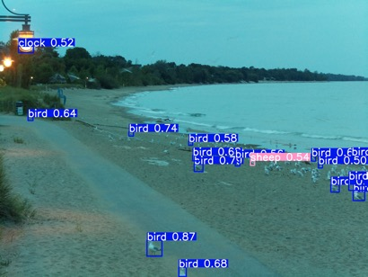
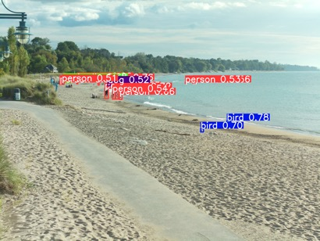
Individual Status Report – Fangi
Small object detection with SAHI+YOLOX
YOLOv5s
YOLOv5s
+ SAHI
* https://huggingface.co/spaces/fcakyon/sahi-yolov5

Slide 20
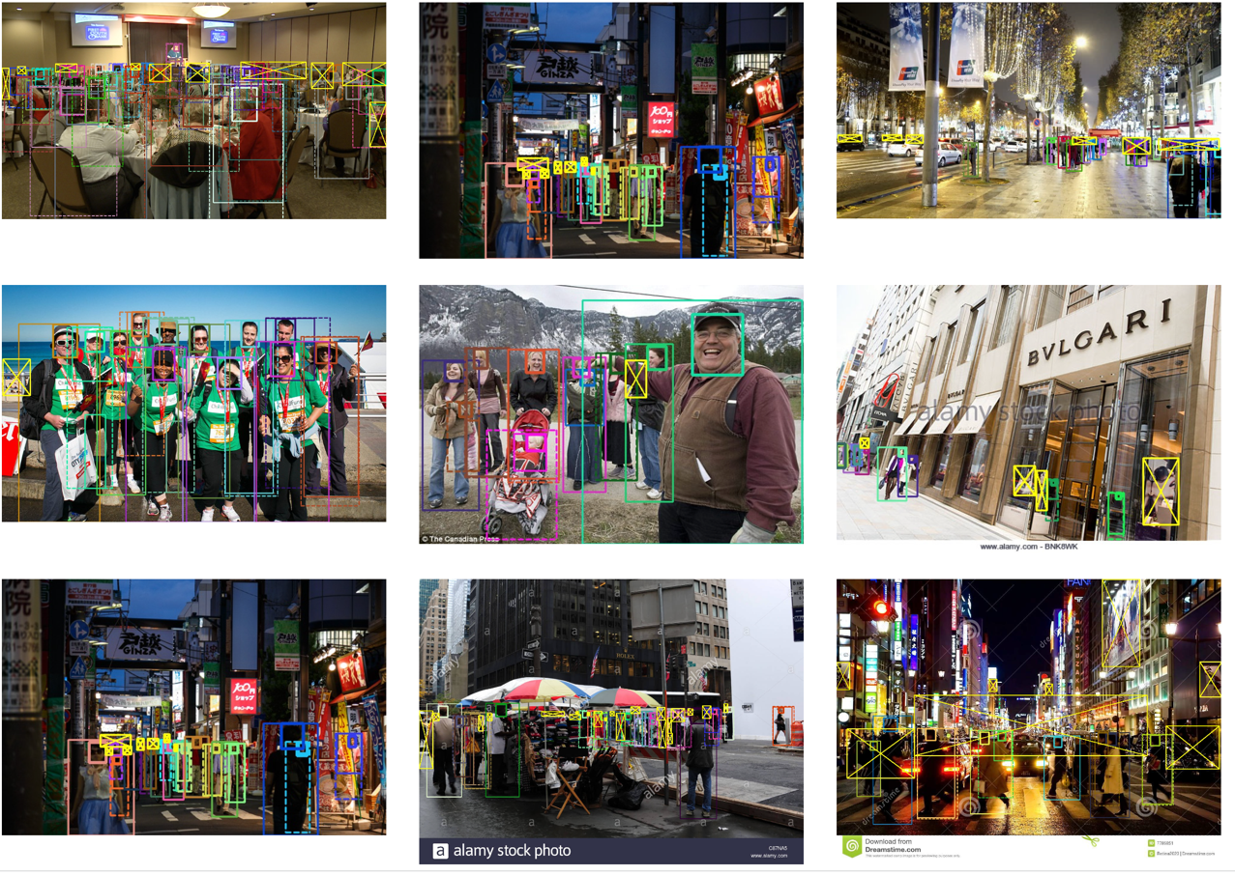
Individual Status Report – Fangi
People counting: dataset and benchmark – head patterns are important
CrowdHuman is a benchmark dataset to better evaluate detectors in crowd scenarios. The CrowdHuman dataset is large, rich-annotated and contains high diversity. CrowdHuman contains 15000, 4370 and 5000 images for training, validation, and testing, respectively. There are a total of 470K human instances from train and validation subsets and 23 persons per image, with various kinds of occlusions in the dataset. Each human instance is annotated with a head bounding-box, human visible-region bounding-box and human full-body bounding-box. We hope our dataset will serve as a solid baseline and help promote future research in human detection tasks.
http://www.crowdhuman.org/

Slide 21
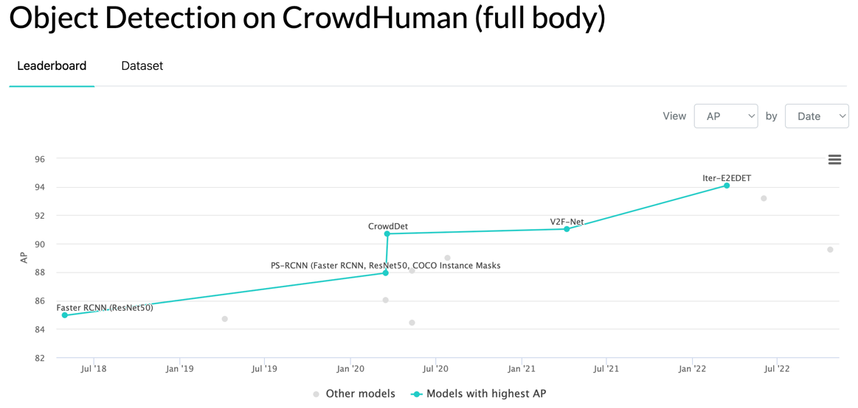
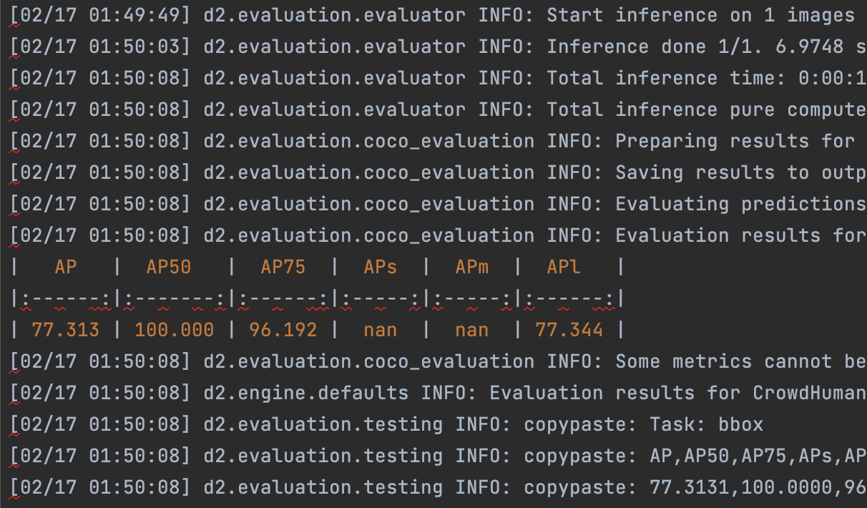
Individual Status Report – Fangi
People counting with Detectron2 Model Zoo APIs
Still working on this candidate
https://paperswithcode.com/sota/object-detection-on-crowdhuman-full-body
https://github.com/facebookresearch/detectron2/blob/main/MODEL_ZOO.md
https://github.com/franciszero/Iter-E2EDET.git

Slide 22
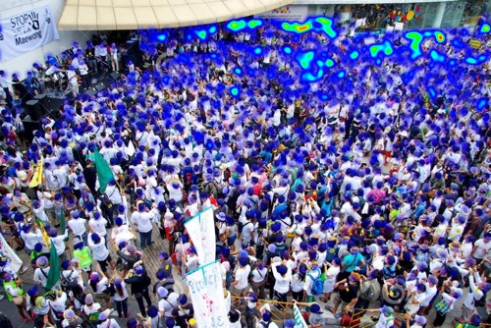
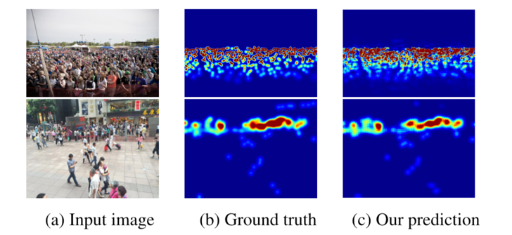
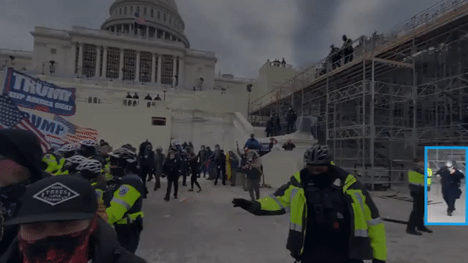
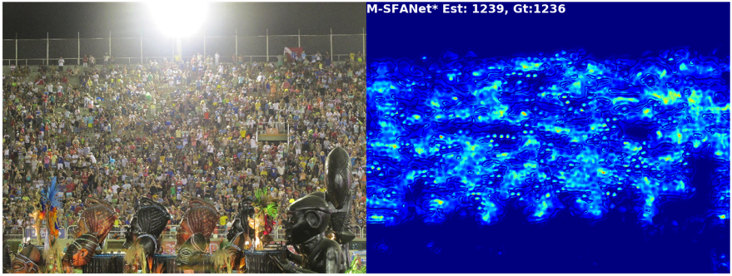
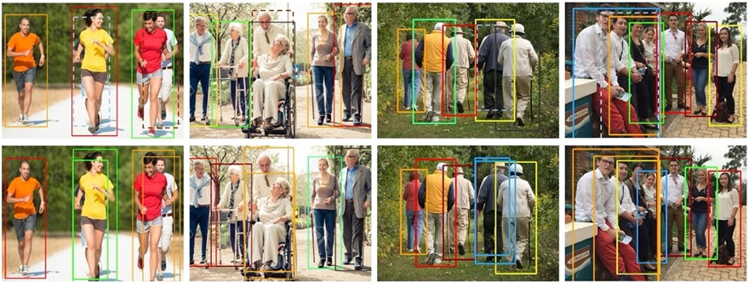
Individual Status Report – Fangi
People counting: other potential options
https://github.com/gpspelle/Crowd-Counting.git
** https://github.com/weizheliu/Context-Aware-Crowd-Counting.git
https://github.com/zhiqic/rethinking-counting
https://github.com/Pongpisit-Thanasutives/Variations-of-SFANet-for-Crowd-Counting
*** https://github.com/megvii-model/CrowdDetection

Slide 23
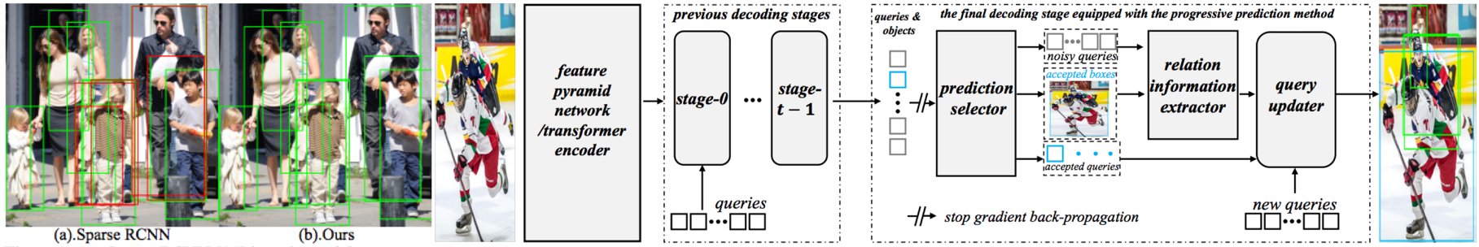
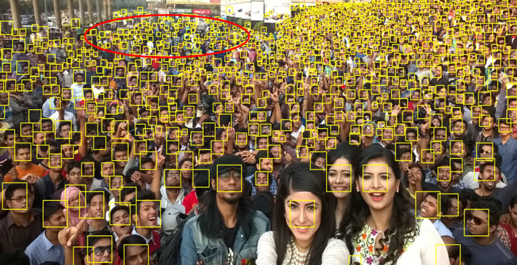
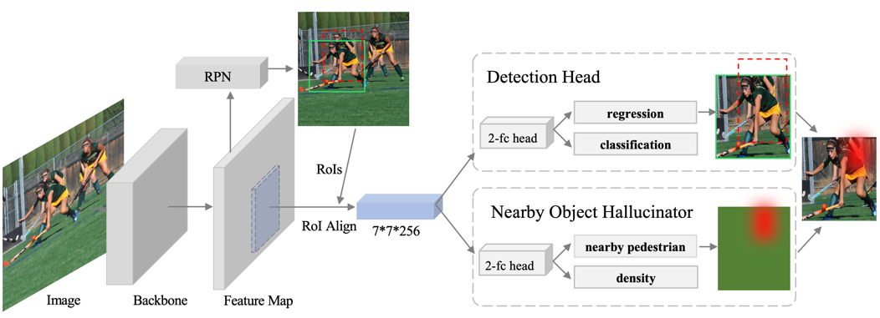
Individual Status Report – Fangi
People counting: other potential options
https://github.com/franciszero/Iter-E2EDET, based on Detectron2 and Sparse-RCNN
* https://github.com/val-iisc/lsc-cnn, for enhanced face anonymizing
** https://github.com/franciszero/PedestrianDetection-NohNMS.git
Platform: https://github.com/facebookresearch/detectron2
Dataset: http://www.crowdhuman.org/
End-To-End People Detection in Crowded Scenes: https://www.youtube.com/watch?v=Nl2fBKxwusQ

Slide 24
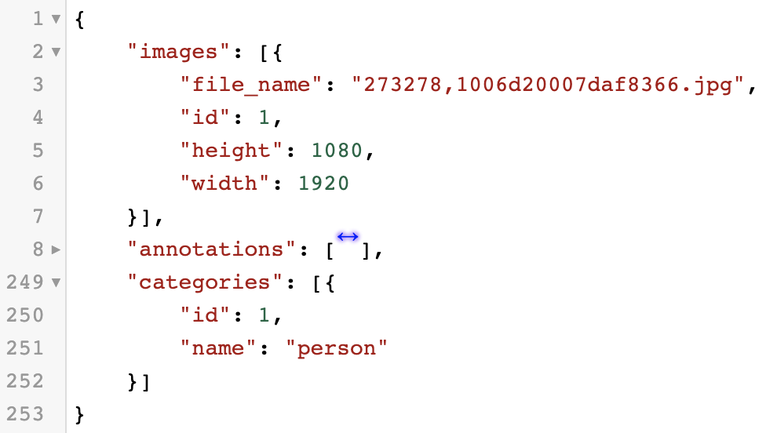
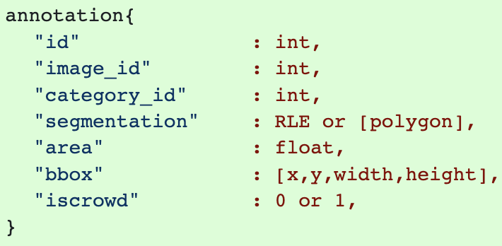
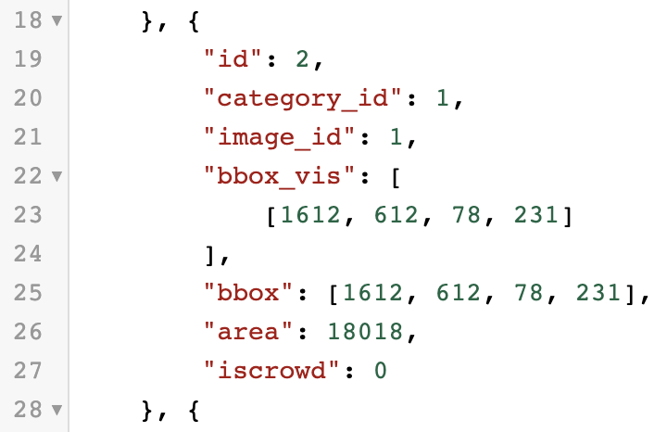
Individual Status Report – Fangi
Model performance metrics under the form of COCO Annotations
COCO annotation format:

Slide 25
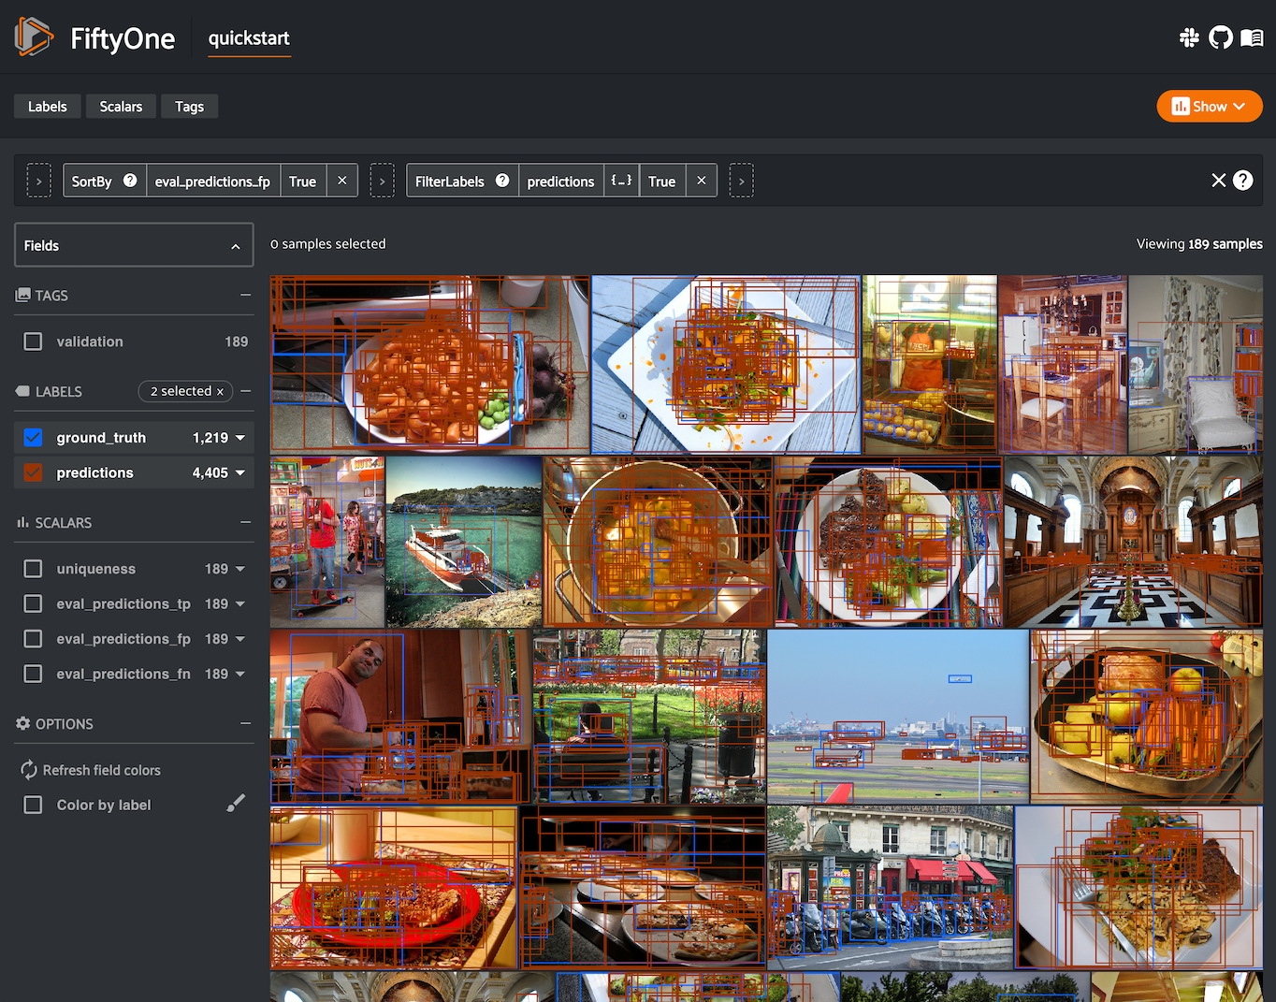
Individual Status Report – Fangi
Model performance metrics under the form of COCO Annotations

Slide 26
Individual Status Report – Scaria:
Worked on the resnet model.
Implemented the counting algorithm.
Notes:
Olexa, Peter (n.d.) A Person Making a Schedule. Accessed on January 18th, 2023 from https://www.pexels.com/photo/a-person-making-a-schedule-14299948/

Slide 27
Activities to be Completed before Next report:
Testing classification model.
Working on better accuracy classification.
Image segmentation on people counting if necessary
Discussing if it is a good option to complete our anonymizing task
Working on Iter-E2EDET and try to get a better result on people counting
EDA on inshore wave data at Bruce Beach
Notes:
Olexa, Peter (n.d.) A Person Making a Schedule. Accessed on January 18th, 2023 from https://www.pexels.com/photo/a-person-making-a-schedule-14299948/

Slide 28
Thank you!
Questions?
Notes:
Image: Leloo, The first (2022) https://www.pexels.com/photo/question-marks-on-paper-crafts-5428833/

